Slide 1

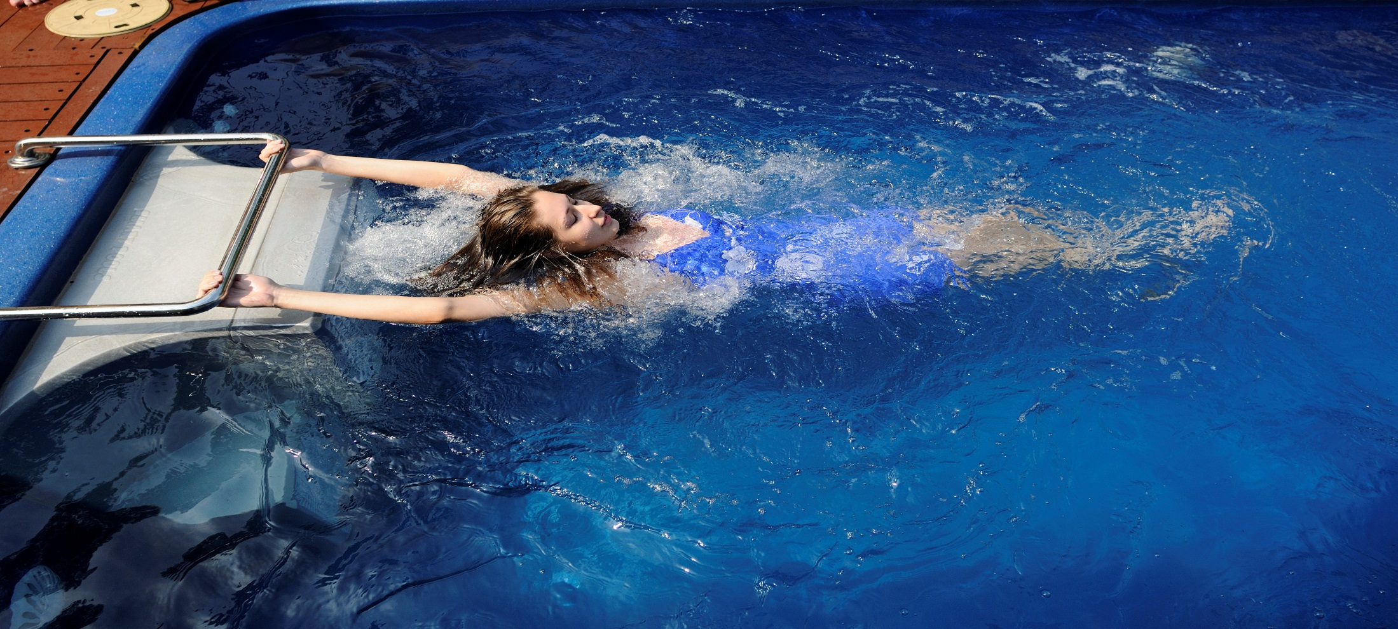
SMARTPOOLS BOOKLET
LIVE THE WATER LIFE

Slide 2


Introduction
SmartPools™ is the world's leading specialist in luxury swim spas, products and solutions. Our award winning range of intelligent swimming solutions have been internationality acclaimed for their innovative design, aesthetics and functionality. You can now experience space savvy, affordable luxury in the comfort and privacy of your own home.
SmartPools™ uses the latest technology that is superior to others in the Western market. Its proprietary Laminar Aqua Propulsion System (LAPS) moves massive quantities of water up to 30,000 liters of water per minute resulting in a fully adjustable, smooth and non turbulent swimming experience.
The installation can be simple or grand according to decor choices. Operation-wise, the SmartPools costs next to nothing to maintain, offers easy maintenance providing durability for decades of hassle-free enjoyment.

Slide 3
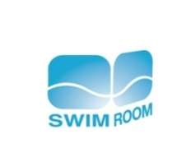



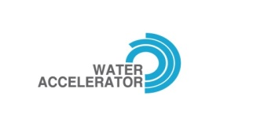






Why SmartPools
Never before size
Just one-time fill
Just 9000 litters of water
From 15’ length x 8’ width x
3.5’ depth to large size, the
Fit it once and that’s it. Unlike
other pools, there’s no refilling.
Unlike a conventional pool that
typically needs about 400,00 its
flagship SmartPools Arena can be installed anywhere even in an apartment.
We have enough technology in it to keep the water clean.
of water, SmartPools uses minimum water.
An Auto-filtration system
Water Accelerator
Continuous oxygenation
Unlike other pools, this is a
pool that takes care of itself.
You can vary the water flow with
an advanced speed control system
The constant flow, ensures that
the water in the pool absorbs
and you can do that instantly.
atmospheric oxygen, keeping the water
oxygenated.
UV C ioniser
Warm? Cold?
Chemical free
SmartPools Arena is equipped
with a UV C ioniser which ensures
You can adjust the water
temperature to your
Research has proven that chlorine
causes cancer. An auto chlorinator
that the water in the pool is UV-Shielded. Anti-
bacterial, ant-fungal, ant-viral and anti-algal, it
Is as pure as potable water.
convenience. Temperature controlled
pools are a rarity and expensive.
reduce chemicals by 95% using chlorine only
when needed. As a result any eye-irritation and
odour is eliminated.
Built to last
Conserving water, saving power
SmartPools Arena in made from Advanced Marine Grade Composite, the same material
Your SmartPools Arena Debut only a one time fill of 9000 litters of water.
used to build luxury yachts. We offer a 10 years warranty on structure. We believe in it, you can too.

Slide 4
Features of SmartPools
SmartPools can be installed Fully in Ground, Half in Ground or Fully above Ground.
SmartPools Electro Mechanical (Filtration) System is fully integrated as a single unit with the main structure of the pool which makes it a Plug -a- Play system.
LAPS (Laminar Aqua Propulsion System) technology which moves up to 30,000 liters of water per minute in a low pressure high volumetric laminar flow pattern resulting in a fully adjustable, smooth and non- turbulent bubble less current. The LAPS technology is the only one in the world where the speed of water can be adjusted from zero to 30,000 liters per minute which enables a person to swim against the current just like swimming in a river. The LAPS technology system is also called Water Treadmill System.

Slide 5
Projects
Brigade Group, Bangalore – 140 pools
Godrej Properties, Bangalore – 10 pools
BBCL, Chennai – 19 pools
Aparna, Bangalore – 8 pools
Confident Group, Bangalore – 10 pools
International Projects
Advenz Tower, Dubai – 177 pools
Malaysia – 1600 pools
Australia – 200 pools

Slide 6
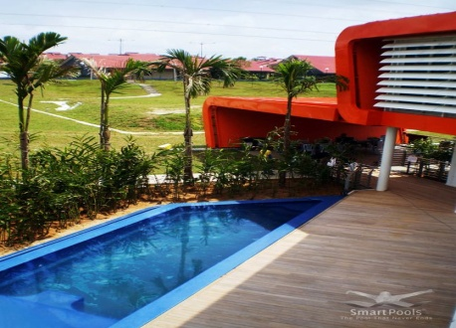
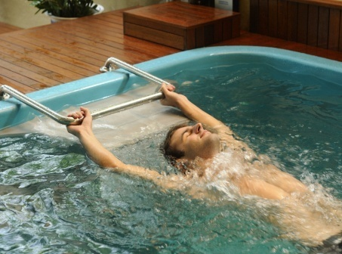
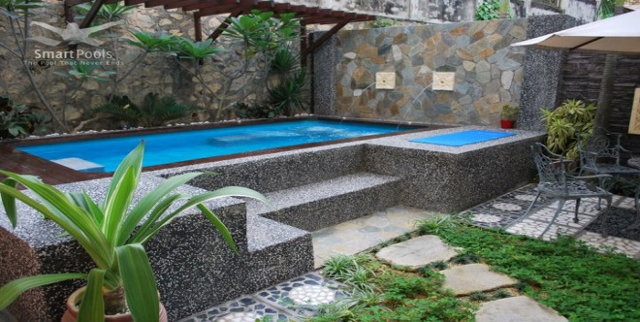
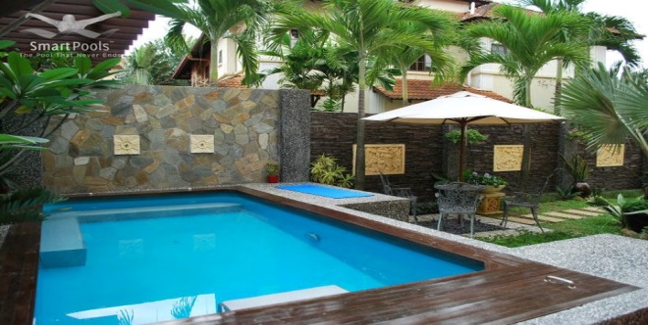
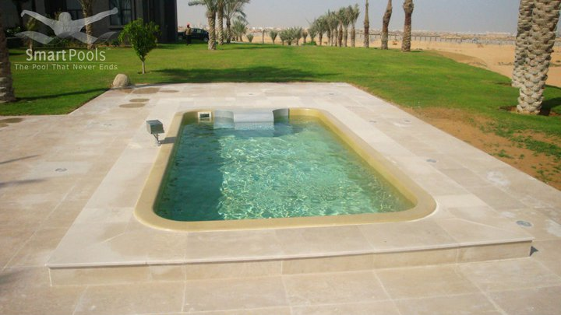
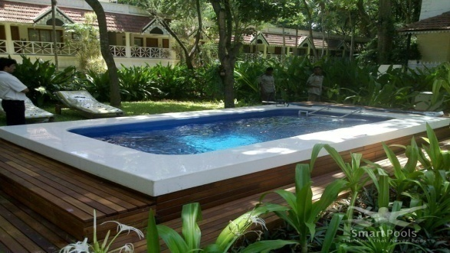
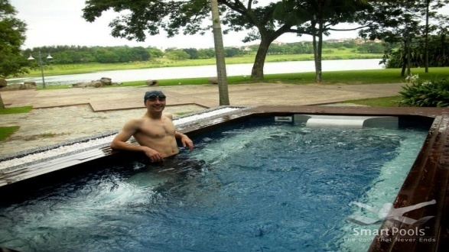
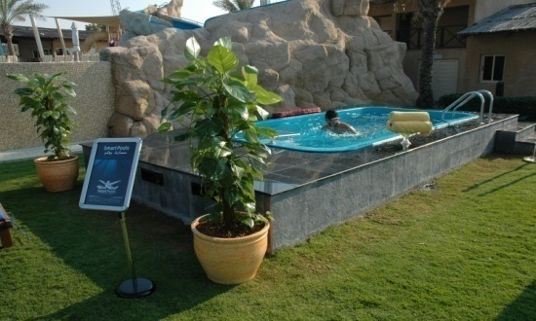
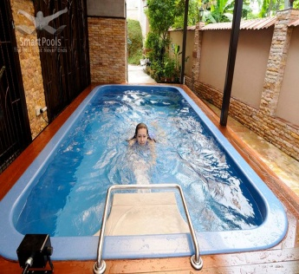
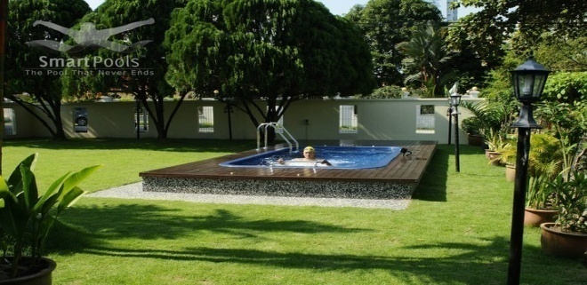
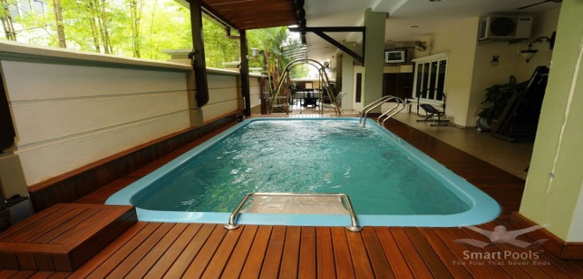
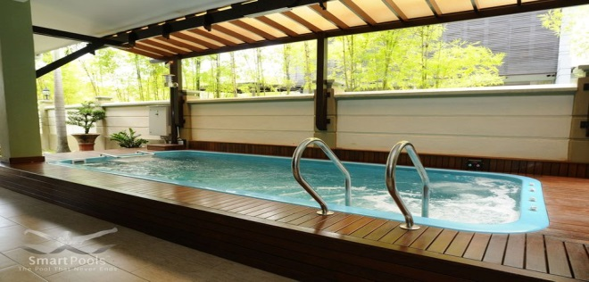

Awards
SmartPools International Pvt. Ltd.
SmartPools House, No.35/1B, Sathnur road, Next to country club, Yelahanka, Bangalore – 560063, India.
Call: +91 99455 55997, Email: anil@smartpools.com.my

